Slide 1

Project1
FUNDING ANALYSIS
James Draper
Kelsey Kraft
Mariah McLelan
Amarilli Novel
Hisako Yamanaka
Notes:
Entered text
Mean
Median
Standard deviation
SE
Correlation
Outlier
Statistical Analysis
aaaaaaaaaaaaaaaaaaaaaaaaaaaaaaaaaaaaaaaaasssssfdhreyrtertertertretertetretretertertretetreterterteterterterterterterteterterterteterlgk;ldfkg;lterks'y;lrk';tylreky';tekrty
;erky
;el,rtË:lg''e;rlte
'r;lt
er';lt
e';ltr
e';lter
';tl
élt
'r;lt
é;lrté;lt''er;lt
';elt
é;rlr
'te;

Slide 2

Research Question
to Answer:
How does the funding allocated to education impact the success of students and schools?

Slide 3

Project goals:
Analyze the impact of education funding on the success of students and schools.
Focusing on the relationship between state funding in Texas education, SAT/ACT scores, and dropout rates.
Determine whether higher funding leads to better outcomes or if there is a point where the impact of funding levels off.

Slide 4


Data sets source:
https://tea.texas.gov/

Slide 5

Mean
Median
Standard deviation
SE
Normality test
Quartile, outliers
Correlation

Slide 6
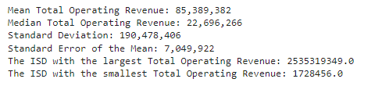
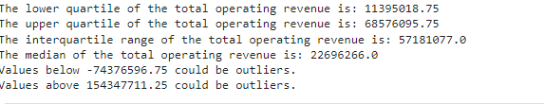
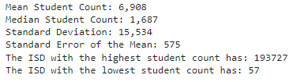
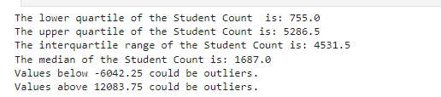

Slide 7

SAT/ACT SCORES

Slide 8
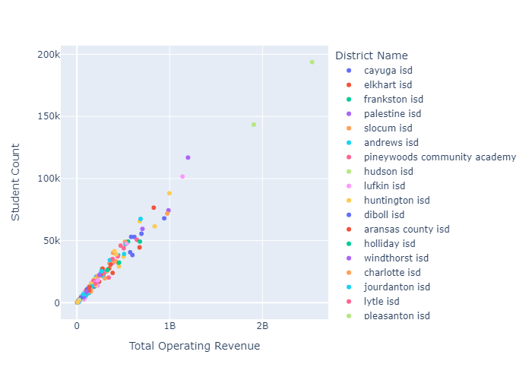
Positive correlation between total operating revenue and student count.

Slide 9
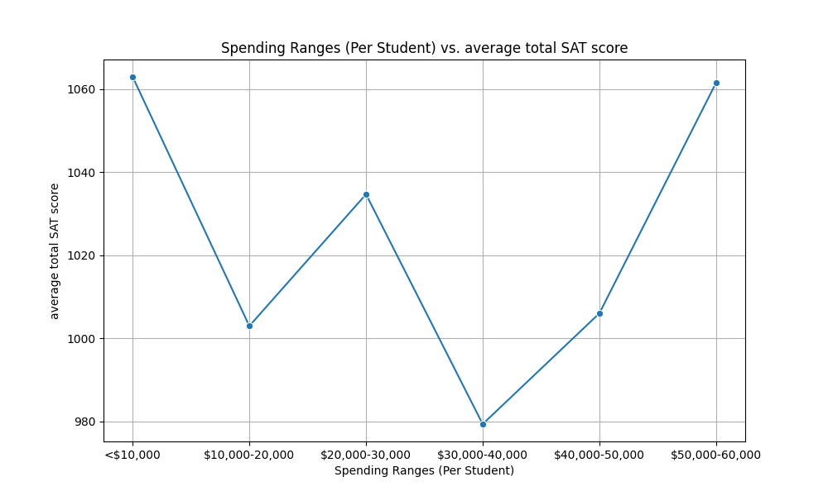
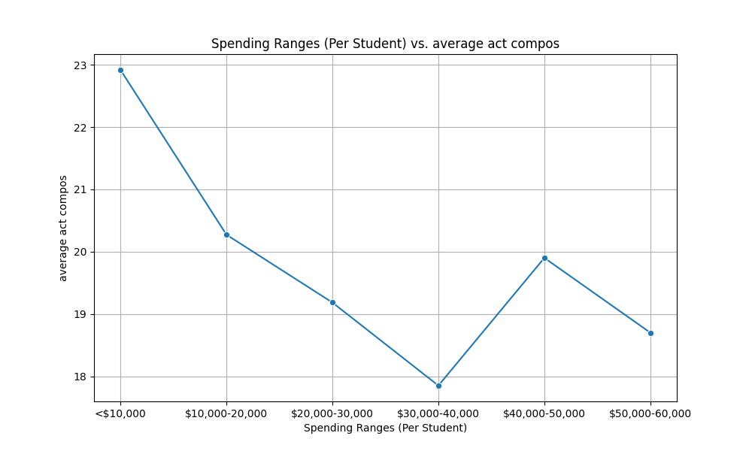
The budget doesn't significantly affect scores:
some schools with smaller budgets scored the highest.
Moreover, smaller schools tend to have higher ACT and SAT scores.

Slide 10
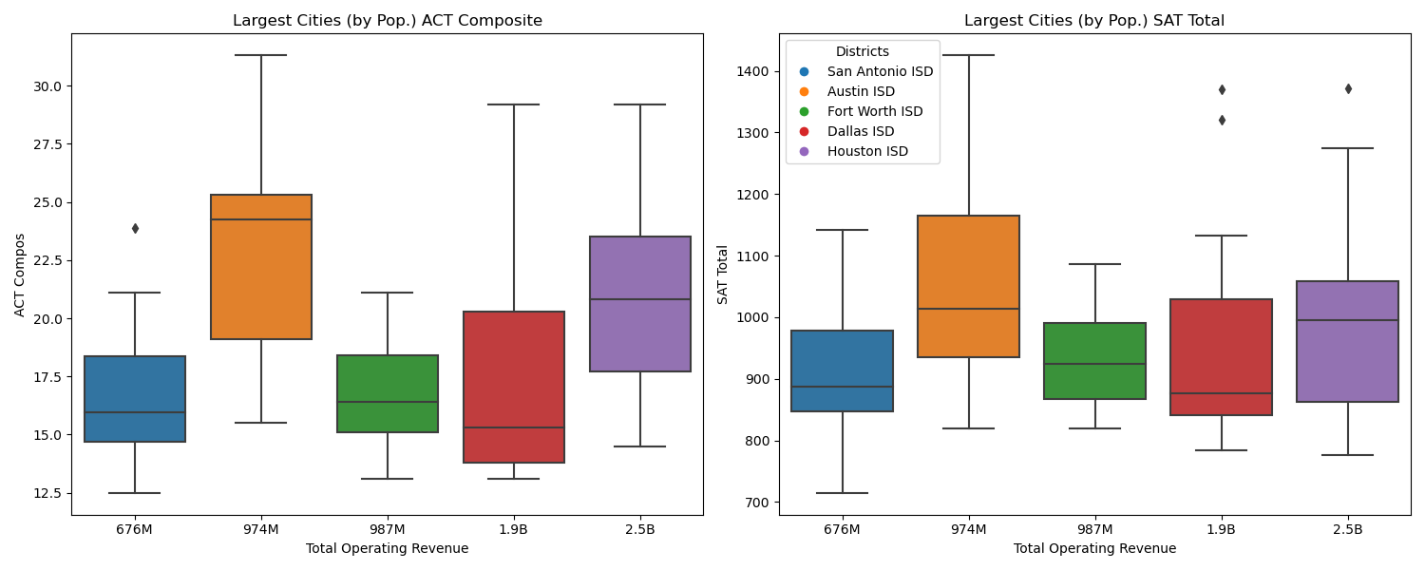
Austin ISD performs the best in both SAT and ACT while having a smaller budget than Fort Worth, Dallas, and Houston.

Slide 11
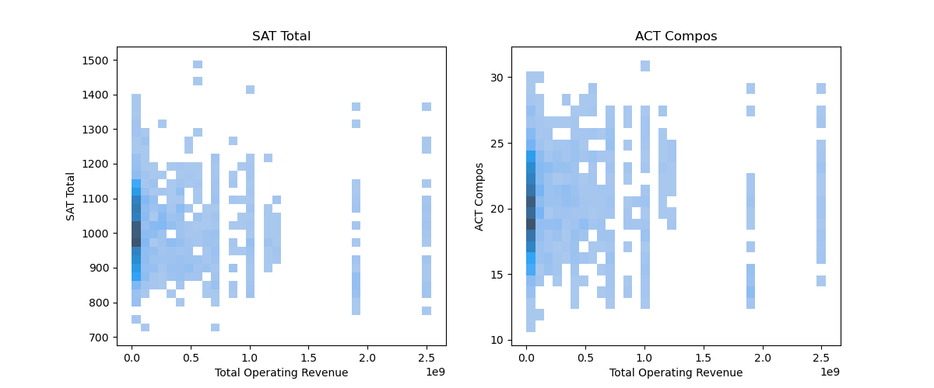
Negative correlation between Total Operating Revenue and ACT Composite and SAT Total scores, as indicated by the values of -0.03 and -0.09.

Slide 12

Interactive tree map:

Slide 13

Dropout rates

Slide 14
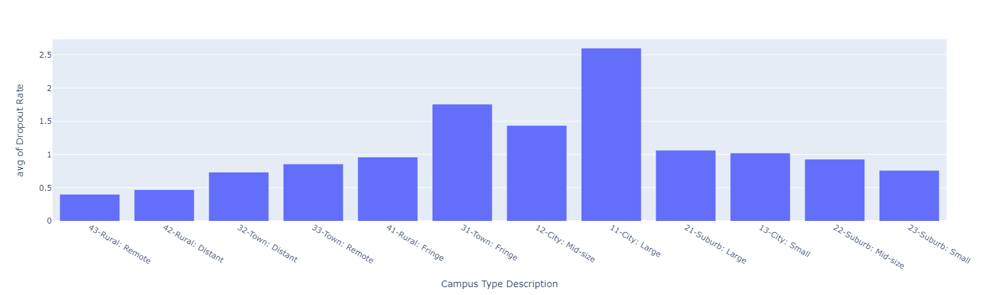
Large Cities have the highest average dropout rate 2.59 % while rural remote towns 0.39 %

Slide 15
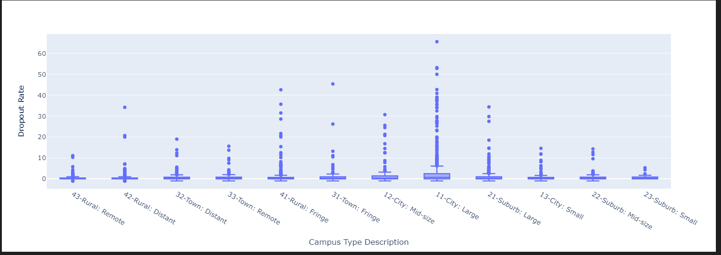
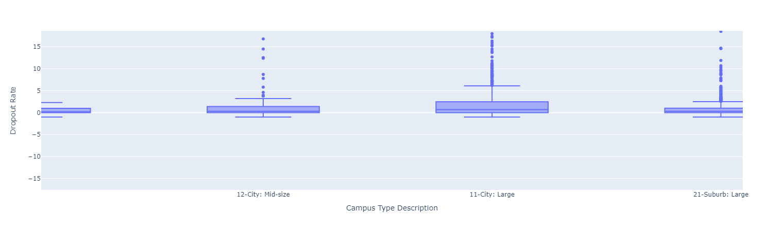
Large Cities and large school districts have the highest dropout rates without outliers, having an upper fence of 6.1 percent

Slide 16
As expected, there is a positive correlation between total operating revenue and student count. That means the more students a school district has, the bigger the funding received.
The budget doesn't significantly affect scores, as some schools with smaller budgets scored the highest. Moreover, smaller schools tend to have higher ACT and SAT scores.
There is a substantial decline in academic scores when the school population increases.
When analyzing the five largest cities in Texas by population, we discovered that Austin ISD performs the best in both SAT and ACT while having a smaller budget than Fort Worth, Dallas, and Houston.
There is a negative correlation between Total Operating Revenue and ACT Composite and SAT Total scores, as indicated by the values of -0.03 and -0.09, respectively.
Smaller schools, on average, perform better than larger schools.
Large cities and large school districts have the highest dropout rates without outliers, having an upper fence of 6.1 percent

Slide 17


